Slide 1

Electronic Health Records using Iris and Fingerprint Recognition System in Medical Emergencies
DEPARTMENT OF COMPUTER SCIENCE & ENGINEERING
SCHOOL OF STUDIES,ENGINEERING AND TECHNOLOGY
GURU GHASIDAS VISHWAVIDYALAYA(A CENTRAL UNIVERSITY)
KONI, BILASPUR
CHHATTISGARH
Presented by:
Abhishek Kumar Singh(20103004)
Yatindra Deo(20103072)
Y Dhanush(20103073)
Guided by:
Vaibhav Kant Singh
Asst. Professor(CSE)

Slide 2
outline
INTRODUCTION
PROBLEM STATEMENT
PROPOSED WORK
IMPLIMENTATION AND RESULT
CONCLUSION AND FUTURE WORK

Slide 3
introduction
BIOMETRIC VERIFICATION
It is a means by which a person can be uniquely identified by evaluating one or more different biological traits.
IRIS RECOGNITION
Iris recognition is a biometric verification technique that uses the unique patterns in a person's iris to identify them.
ELECTRONIC HEALTH RECORD SYSTEM
An electronic record system that store person’s all previous medical record and medications.

Slide 4

Problem statement
Handling paper based medical report for longer period of time and taking it everywhere we go, is quite difficult. And also in case of any accident if the injured person is not able to tell about itself, so medical team has to use medication on its own risk without knowing whether the person is the allergic to particular medicine and without knowing previous medical history of subject.

Slide 5
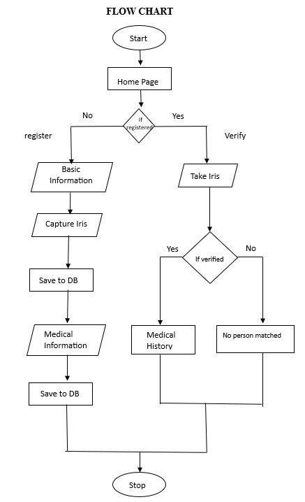
Proposed work

Slide 6
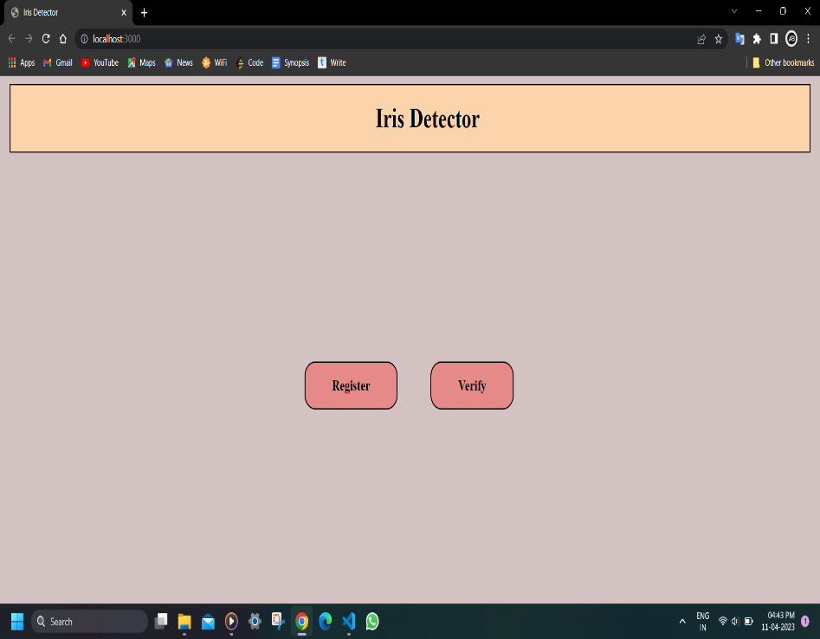

implementation AND RESULT
Output page
Homepage

Slide 7

CONCLUSION AND FUTURE WORK
Electronic health records using iris and fingerprint identification can be a landmark achievement in medical field.
In future we can add many features like registering doctors, feature to upload medical report for better evaluation.

Slide 8


Slide 9


